Slide 1
F0 Analysis
Summary

Slide 2
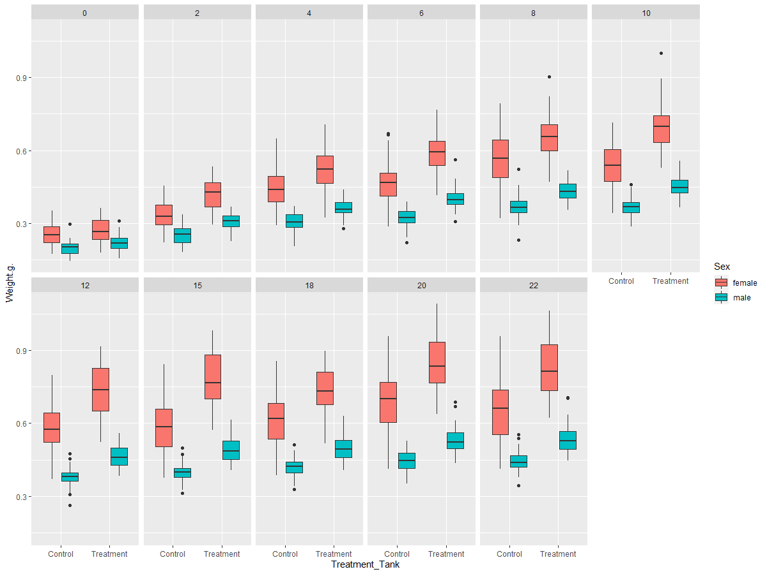
Body weight

Slide 3
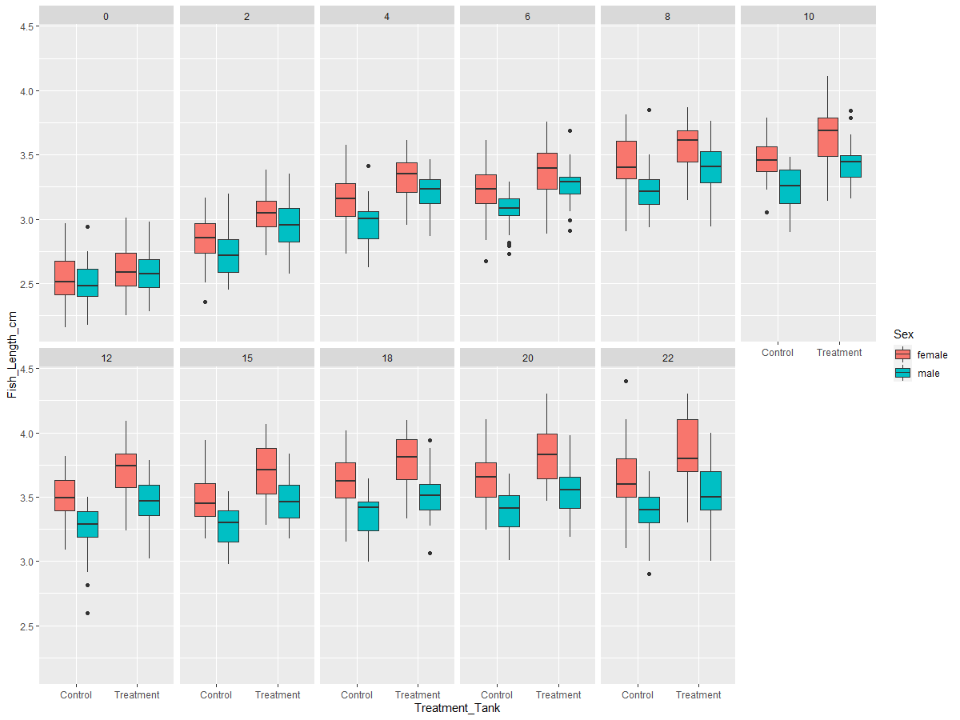
Body length

Slide 4
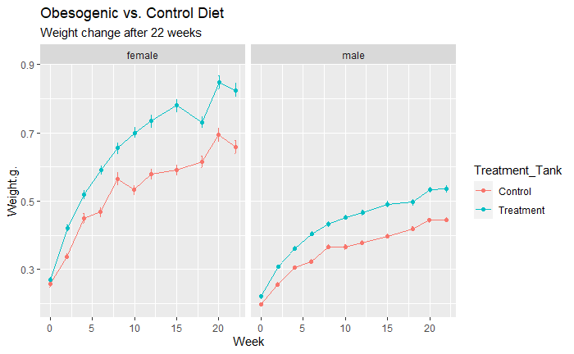
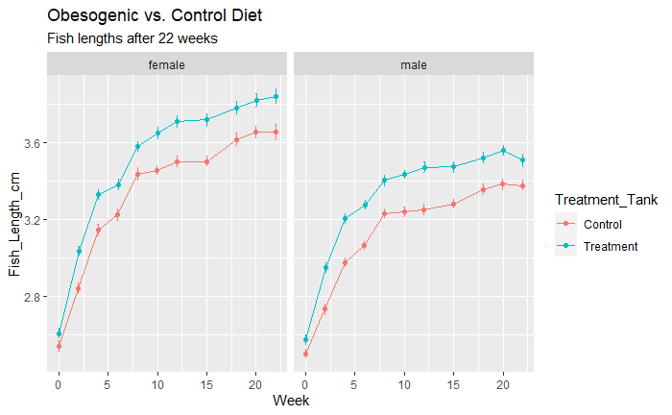
Body weight and body length
Notes:
Shinichi and I also ran mixed models to determine whether the starting weights were statistically insignificant or not
Takes into account fish id’s which were removed from analysis due to reasons such as illness or not being part of main 20 fish of control and treatment groups (tanks 1-4), will check these ID’s individually anyway
Need to add in the dates when breeding occurred, usually accounts for the loss of weight in females
Have asked Annabell to re-do the last week for the males (fish lengths) however I also have done the last week, will this be ok?
Need to do mixed models
N=80 males and 80 females (160 fish; with some replaced here and there, will need more detailed information on these)

Slide 5
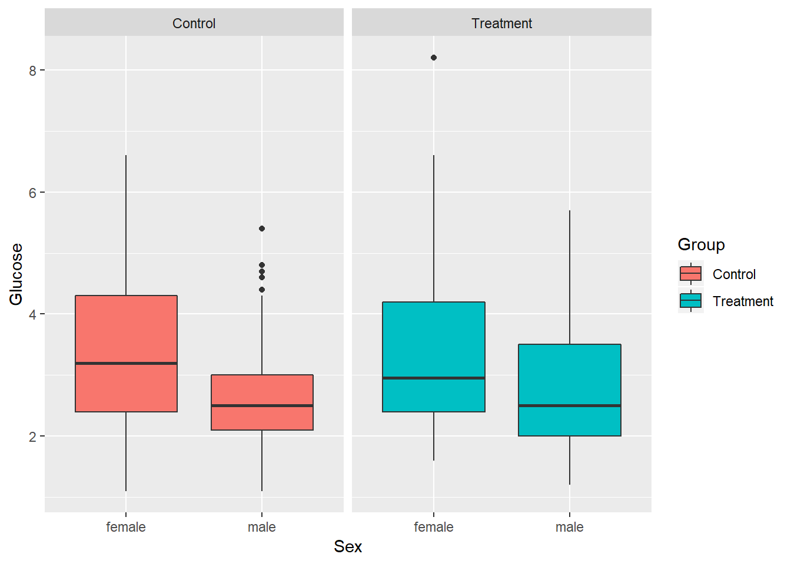
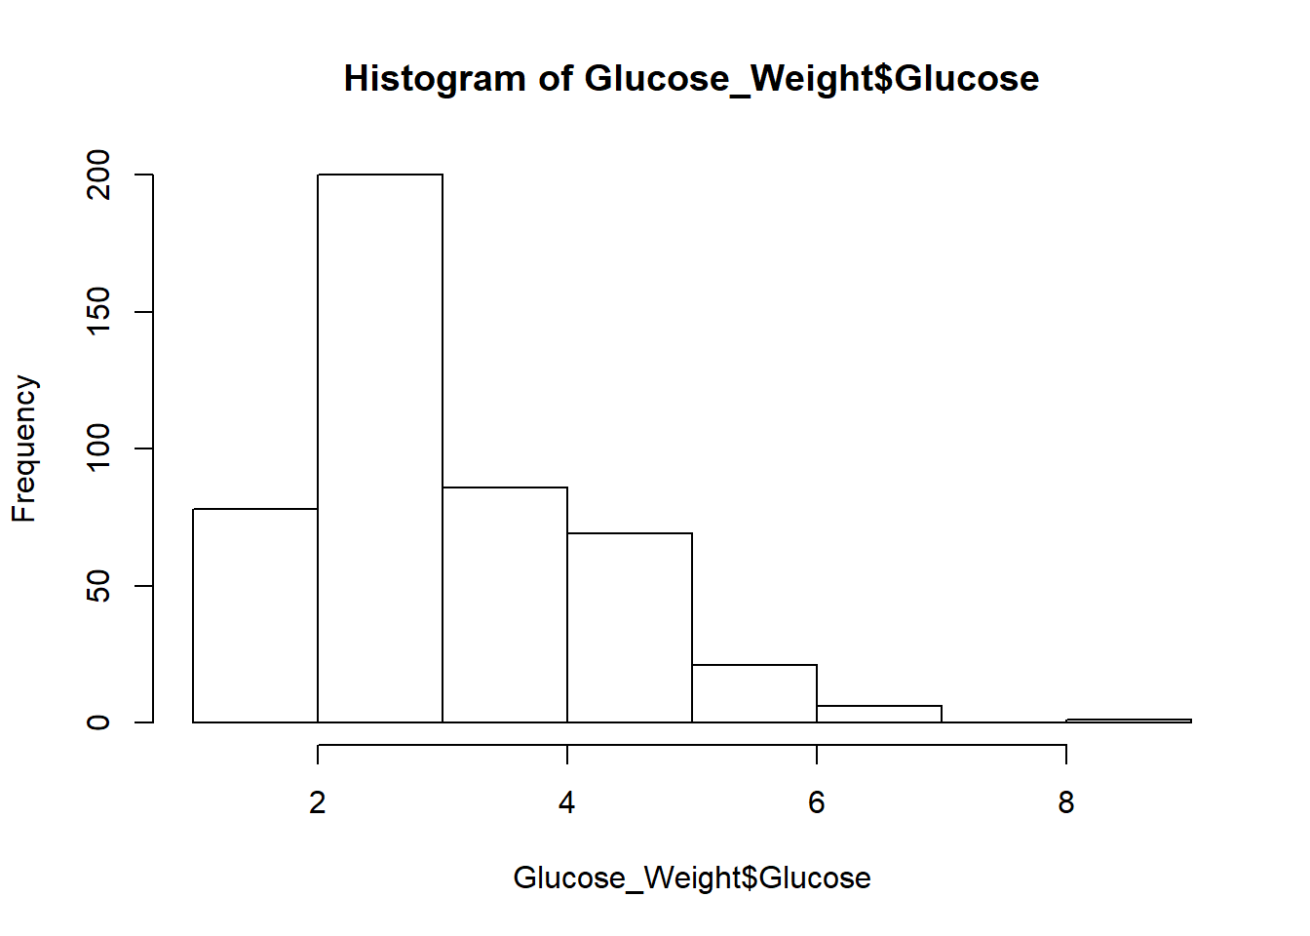
Glucose

Slide 6
Glucose
 | Glucose
Predictors | Estimates | CI | p
(Intercept) | 3.28 | 3.04 – 3.53 | <0.001
Sexmale | -0.64 | -0.93 – -0.35 | <0.001
GroupTreatment | 0.07 | -0.21 – 0.36 | 0.668
Random Effects
σ² | 0.05
τ₀₀ _{Fish_ID} | 1.17
ICC _{Fish_ID} | 0.96
Observations | 461
Marginal R² / Conditional R² | 0.078 / 0.962

Slide 7
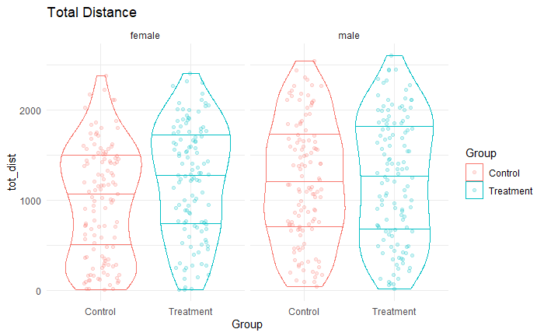
Anxiety (Total distance)

Slide 8
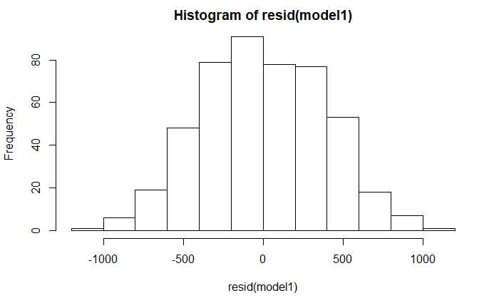
Anxiety (total distance)
Predictors | Estimates | CI | p
(Intercept) | 1023.17 | 901.58 – 1144.76 | <0.001
GroupTreatment | 142.09 | 1.25 – 282.92 | 0.099
Sexmale | 110.86 | -28.65 – 250.38 | 0.193
Random Effects
σ² | 198712.85
τ₀₀ _{Fish_ID} | 229658.88
ICC _{Fish_ID} | 0.54
Observations | 478
Marginal R² / Conditional R² | 0.019 / 0.545

Slide 9
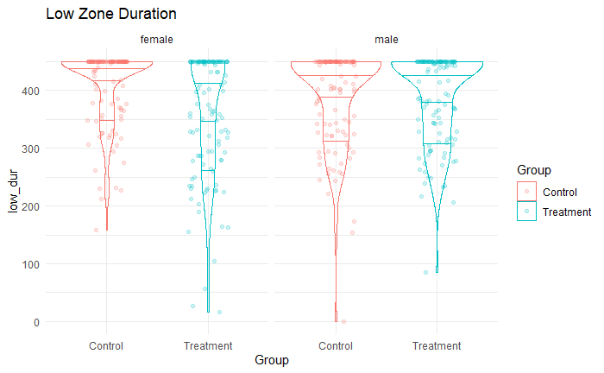
Anxiety (Time spent in low zone)

Slide 10
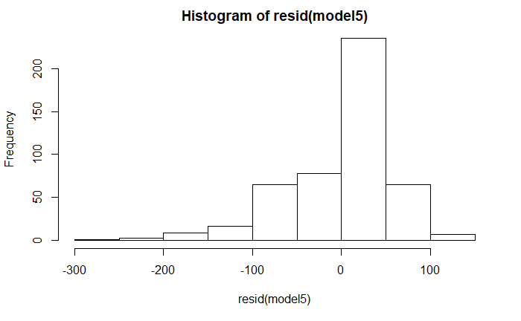
Time spent in low zone
Predictors | Estimates | CI | p
(Intercept) | 398.93 | 384.27 – 413.60 | <0.001
GroupTreatment | -26.18 | -43.15 – -9.21 | 0.012
Sexmale | 3.61 | -13.27 – 20.49 | 0.725
Random Effects
σ² | 4349.55
τ₀₀ _{Fish_ID} | 2833.53
ICC _{Fish_ID} | 0.39
Observations | 478
Marginal R² / Conditional R² | 0.024 / 0.409

Slide 11
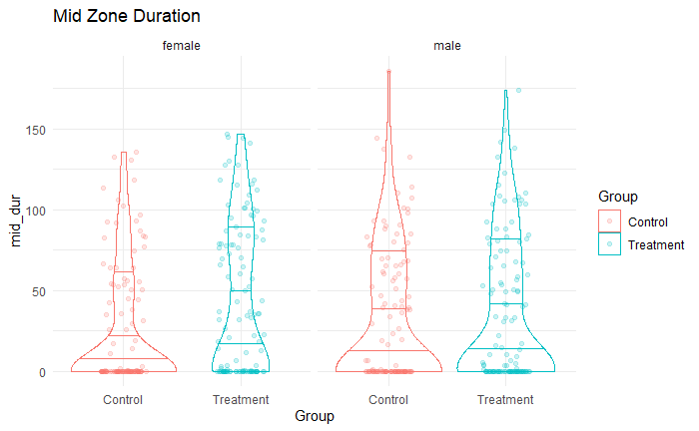
Time spent in mid zone

Slide 12
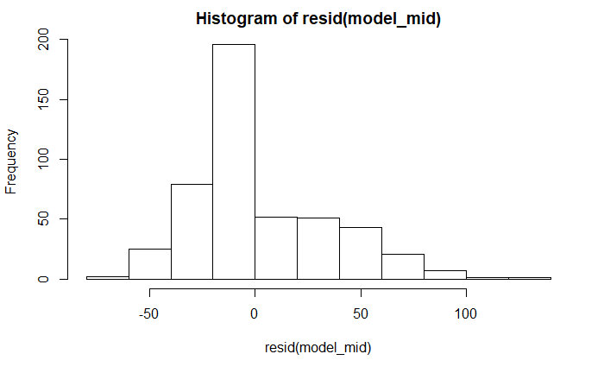
Time spent in mid zone
Predictors | Estimates | CI | p
(Intercept) | 27.63 | 20.73 – 34.54 | <0.001
GroupTreatment | 11.23 | 3.25 – 19.22 | 0.022
Sexmale | 1.07 | -6.89 – 9.03 | 0.825
Random Effects
σ² | 1306.14
τ₀₀ _{Fish_ID} | 510.87
ICC _{Fish_ID} | 0.28
Observations | 478
Marginal R² / Conditional R² | 0.017 / 0.294

Slide 13
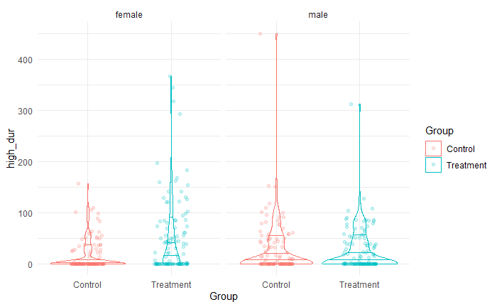
Time spent in high zone

Slide 14
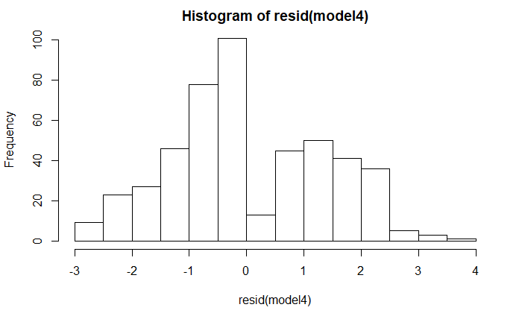
Time spent in high zone
log(high dur+1)
Predictors | Estimates | CI | p
(Intercept) | 1.36 | 1.02 – 1.70 | <0.001
GroupTreatment | 0.61 | 0.21 – 1.00 | 0.012
Sexmale | 0.05 | -0.34 – 0.44 | 0.829
Random Effects
σ² | 2.39
τ₀₀ _{Fish_ID} | 1.50
ICC _{Fish_ID} | 0.39
Observations | 478
Marginal R² / Conditional R² | 0.023 / 0.401

Slide 15
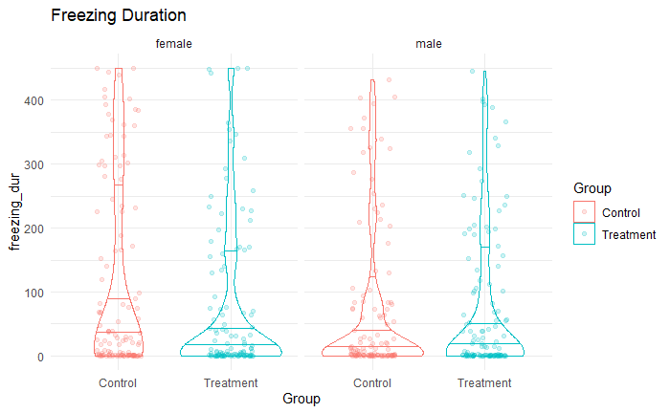
Time spent freezing

Slide 16
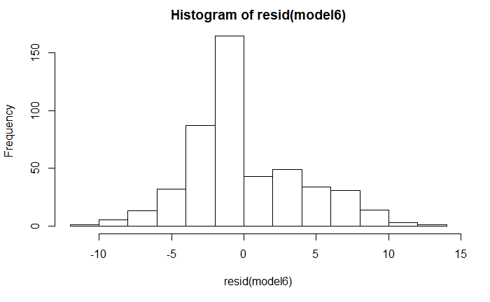
Time spent freezing
sqrt(freezing dur)
Predictors | Estimates | CI | p
(Intercept) | 7.20 | 6.02 – 8.38 | <0.001
GroupTreatment | -0.75 | -2.12 – 0.62 | 0.371
Sexmale | -0.94 | -2.30 – 0.42 | 0.257
Random Effects
σ² | 21.09
τ₀₀ _{Fish_ID} | 20.91
ICC _{Fish_ID} | 0.50
Observations | 478
Marginal R² / Conditional R² | 0.009 / 0.502

Slide 17
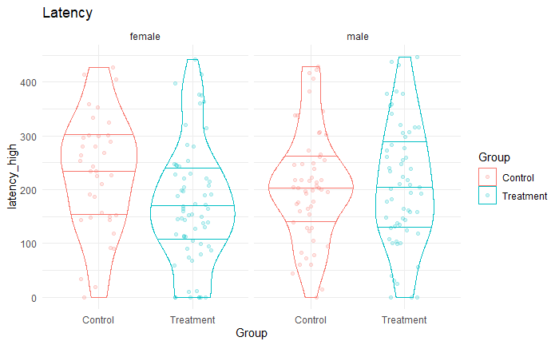
Latency to high zone

Slide 18
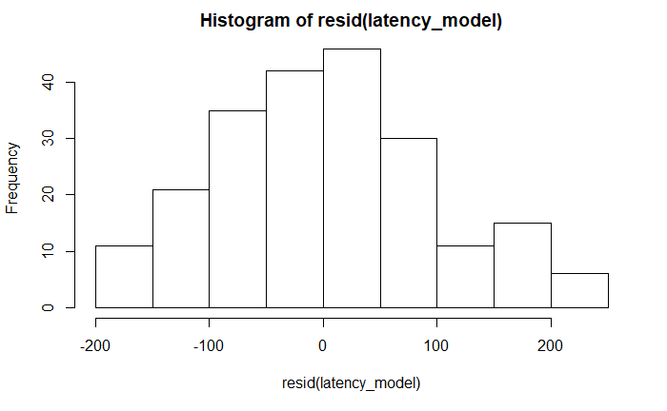
Latency to high zone
Predictors | Estimates | CI | p
(Intercept) | 208.24 | 182.86 – 233.62 | <0.001
GroupTreatment | -23.59 | -50.24 – 3.05 | 0.148
Sexmale | 11.14 | -15.24 – 37.52 | 0.489
Random Effects
σ² | 10458.60
τ₀₀ _{Fish_ID} | 1483.97
ICC _{Fish_ID} | 0.12
Observations | 217
Marginal R² / Conditional R² | 0.015 / 0.137

Slide 19
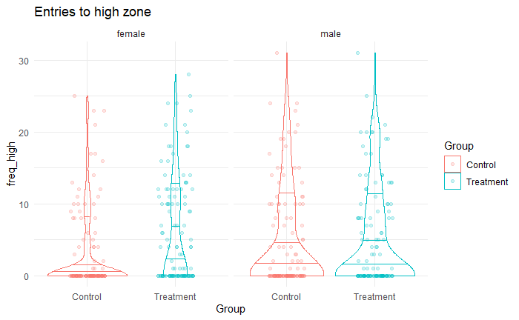
Entries to high zone

Slide 20
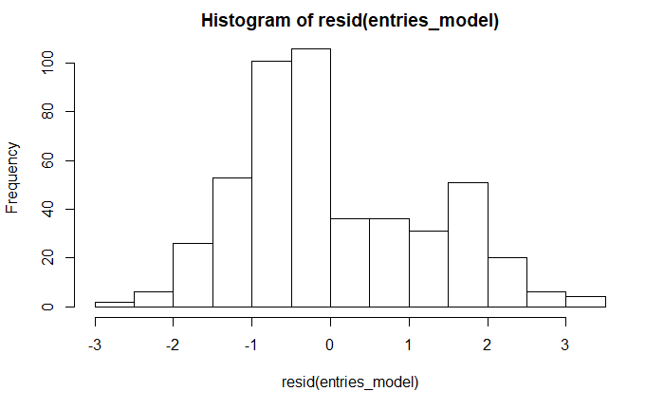
Entries to high zone
sqrt(freq high)
Predictors | Estimates | CI | p
(Intercept) | 1.08 | 0.79 – 1.36 | <0.001
GroupTreatment | 0.46 | 0.13 – 0.78 | 0.023
Sexmale | 0.11 | -0.21 – 0.44 | 0.564
Random Effects
σ² | 1.79
τ₀₀ _{Fish_ID} | 0.99
ICC _{Fish_ID} | 0.36
Observations | 478
Marginal R² / Conditional R² | 0.020 / 0.368

Slide 21
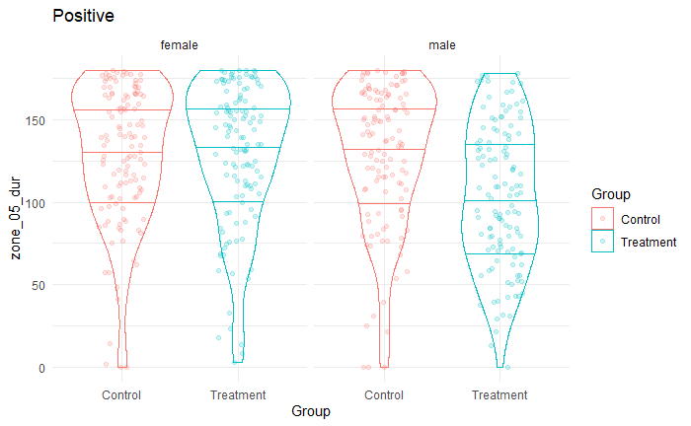
Optimism (positive analysis – 0-5cm from screen)

Slide 22
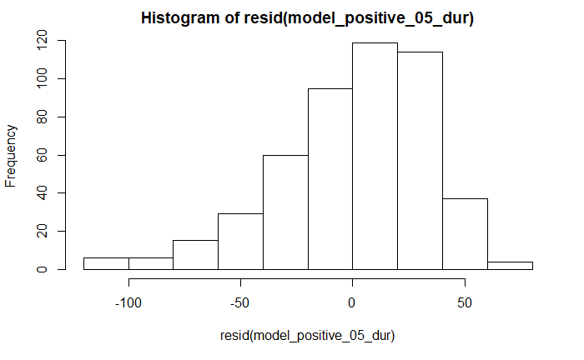
Optimism (positive analysis – 0-5cm from screen)
Predictors | Estimates | CI | p
(Intercept) | 128.70 | 120.88 – 136.51 | <0.001
GroupTreatment | 0.12 | -10.94 – 11.17 | 0.986
Sexmale | 0.12 | -10.94 – 11.18 | 0.986
GroupTreatment:Sexmale | -25.18 | -40.78 – -9.57 | 0.009
Random Effects
σ² | 1365.74
τ₀₀ _{Fish_ID} | 462.52
ICC _{Fish_ID} | 0.25
Observations | 485
Marginal R² / Conditional R² | 0.061 / 0.298

Slide 23
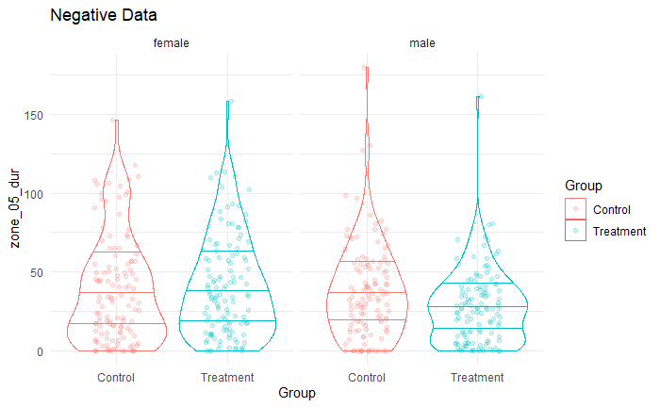
Optimism (negative analysis – 0-5cm from screen)

Slide 24
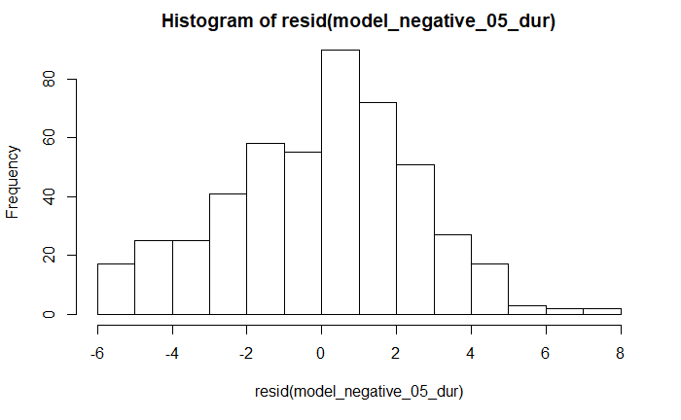
Optimism (negative analysis – 0-5cm from screen)
sqrt(zone 05 dur)
Predictors | Estimates | CI | p
(Intercept) | 5.47 | 5.04 – 5.91 | <0.001
GroupTreatment | 0.28 | -0.34 – 0.89 | 0.460
Sexmale | 0.02 | -0.60 – 0.64 | 0.957
GroupTreatment:Sexmale | -1.09 | -1.96 – -0.23 | 0.040
Random Effects
σ² | 6.98
τ₀₀ _{Fish_ID} | 0.50
ICC _{Fish_ID} | 0.07
Observations | 485
Marginal R² / Conditional R² | 0.021 / 0.087

Slide 25
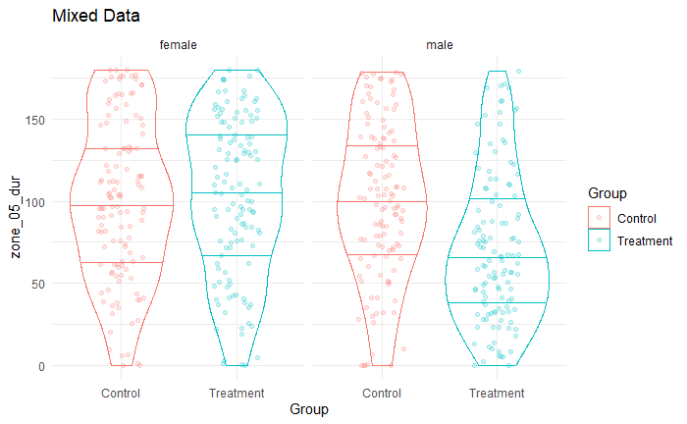
Optimism (mixed stim analysis – 0-5cm from screen)

Slide 26
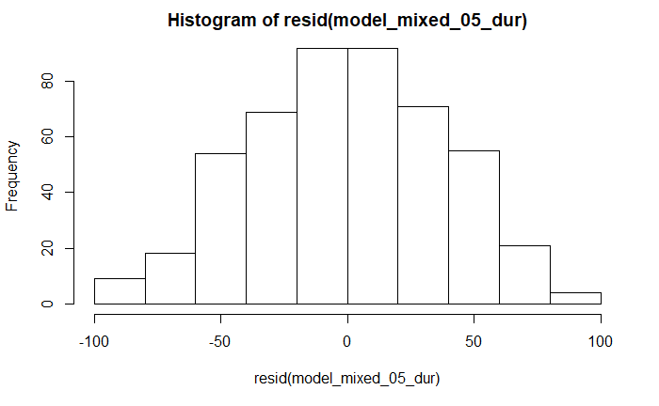
Optimism (mixed stim analysis – 0-5cm from screen)
Predictors | Estimates | CI | p
(Intercept) | 100.08 | 91.40 – 108.76 | <0.001
GroupTreatment | 1.85 | -10.44 – 14.13 | 0.805
Sexmale | 0.73 | -11.56 – 13.02 | 0.923
GroupTreatment:Sexmale | -30.66 | -48.00 – -13.32 | 0.004
Random Effects
σ² | 1732.02
τ₀₀ _{Fish_ID} | 555.49
ICC _{Fish_ID} | 0.24
Observations | 485
Marginal R² / Conditional R² | 0.065 / 0.292

Slide 27
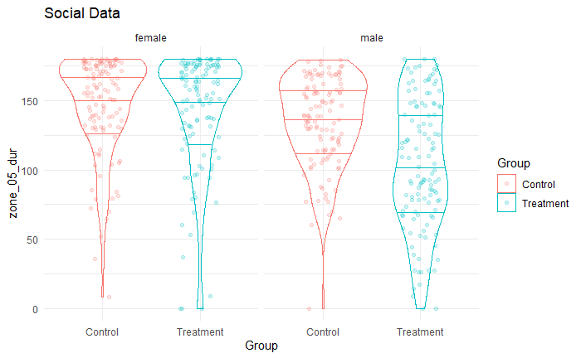
Personality – social (0-5cm from screen)
Notes:
Have other parameters (total distance, time spent freezing etc.)
Looking at time spent near screen

Slide 28
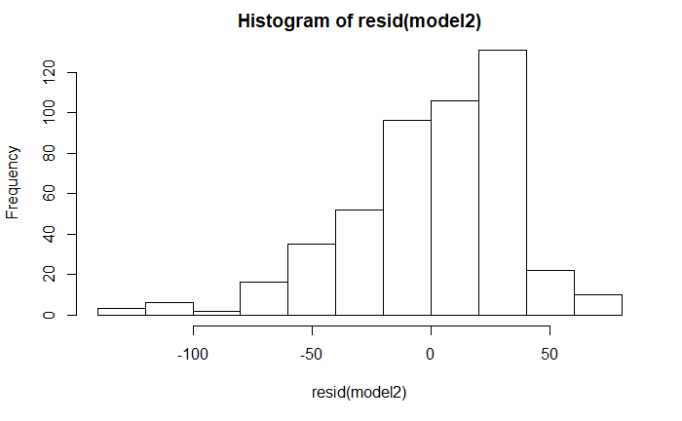
Personality – social (0-5cm from screen)
Predictors | Estimates | CI | p
(Intercept) | 147.57 | 140.81 – 154.33 | <0.001
GroupTreatment | -5.27 | -14.88 – 4.35 | 0.369
Sexmale | -12.80 | -22.41 – -3.20 | 0.030
GroupTreatment:Sexmale | -25.19 | -38.77 – -11.62 | 0.003
Random Effects
σ² | 1318.95
τ₀₀ _{Fish_ID} | 244.11
ICC _{Fish_ID} | 0.16
Observations | 479
Marginal R² / Conditional R² | 0.154 / 0.286

Slide 29
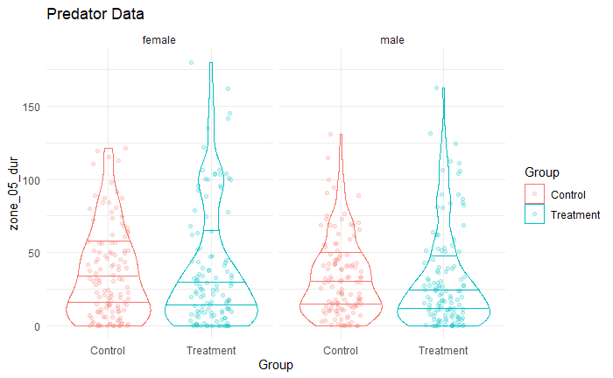
Personality – predator (0-5cm from screen)

Slide 30
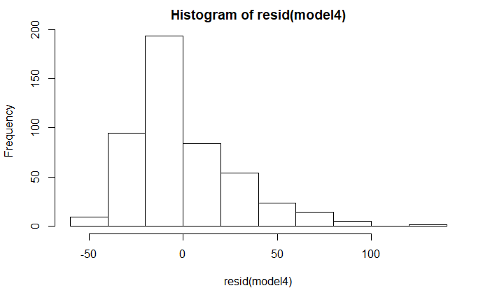
Personality – predator (0-5cm from screen)
Predictors | Estimates | CI | p
(Intercept) | 36.38 | 31.15 – 41.61 | <0.001
GroupTreatment | 0.41 | -5.64 – 6.46 | 0.911
Sexmale | -4.78 | -10.83 – 1.27 | 0.196
Random Effects
σ² | 854.45
τ₀₀ _{Fish_ID} | 260.76
ICC _{Fish_ID} | 0.23
Observations | 479
Marginal R² / Conditional R² | 0.005 / 0.238

Slide 31
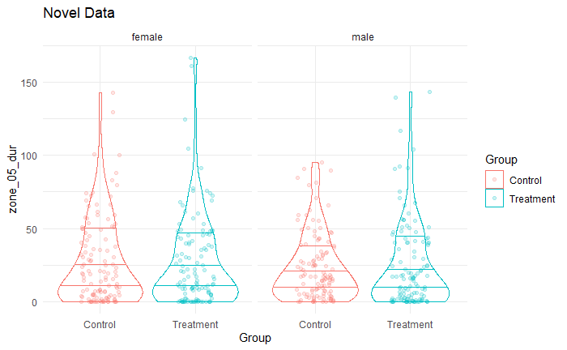
Personality – novel (0-5cm from screen)

Slide 32
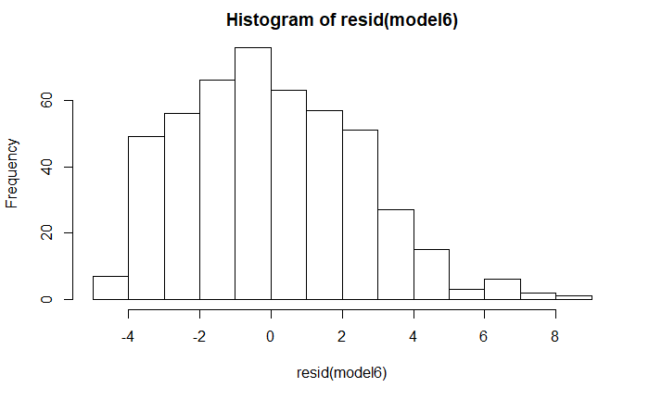
Personality – novel (0-5cm from screen)
sqrt(zone 05 dur)
Predictors | Estimates | CI | p
(Intercept) | 4.35 | 3.93 – 4.78 | <0.001
GroupTreatment | -0.18 | -0.68 – 0.31 | 0.547
Sexmale | -0.18 | -0.67 – 0.32 | 0.559
Random Effects
σ² | 6.94
τ₀₀ _{Fish_ID} | 1.32
ICC _{Fish_ID} | 0.16
Observations | 479
Marginal R² / Conditional R² | 0.002 / 0.162

Slide 33
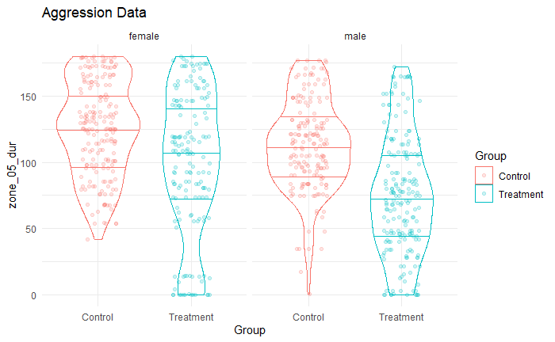
Personality – Aggression (0-5cm from screen)

Slide 34
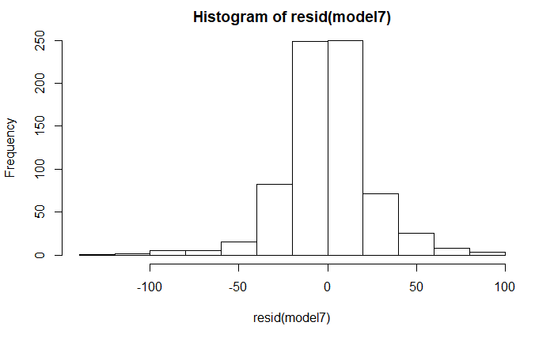
Personality – Aggression (0-5cm from screen)
Predictors | Estimates | CI | p
(Intercept) | 129.75 | 121.85 – 137.66 | <0.001
GroupTreatment | -31.72 | -40.91 – -22.53 | <0.001
Sexmale | -21.13 | -30.32 – -11.94 | <0.001
Random Effects
σ² | 770.42
τ₀₀ _{Fish_ID} | 1063.90
ICC _{Fish_ID} | 0.58
Observations | 716
Marginal R² / Conditional R² | 0.174 / 0.653

Slide 35
learning
We assessed learning by observing the difference between the baseline period (before conditioning with the electric shock) and the probe period (after the conditioning) for the conditioned stimulus (blue colour). The less time spent in the blue colour during the probe period indicates the fish learnt to associate that colour with the shock and actively avoid it. The ‘smartest’ fish would therefore have the highest baseline-probe difference.

Slide 36
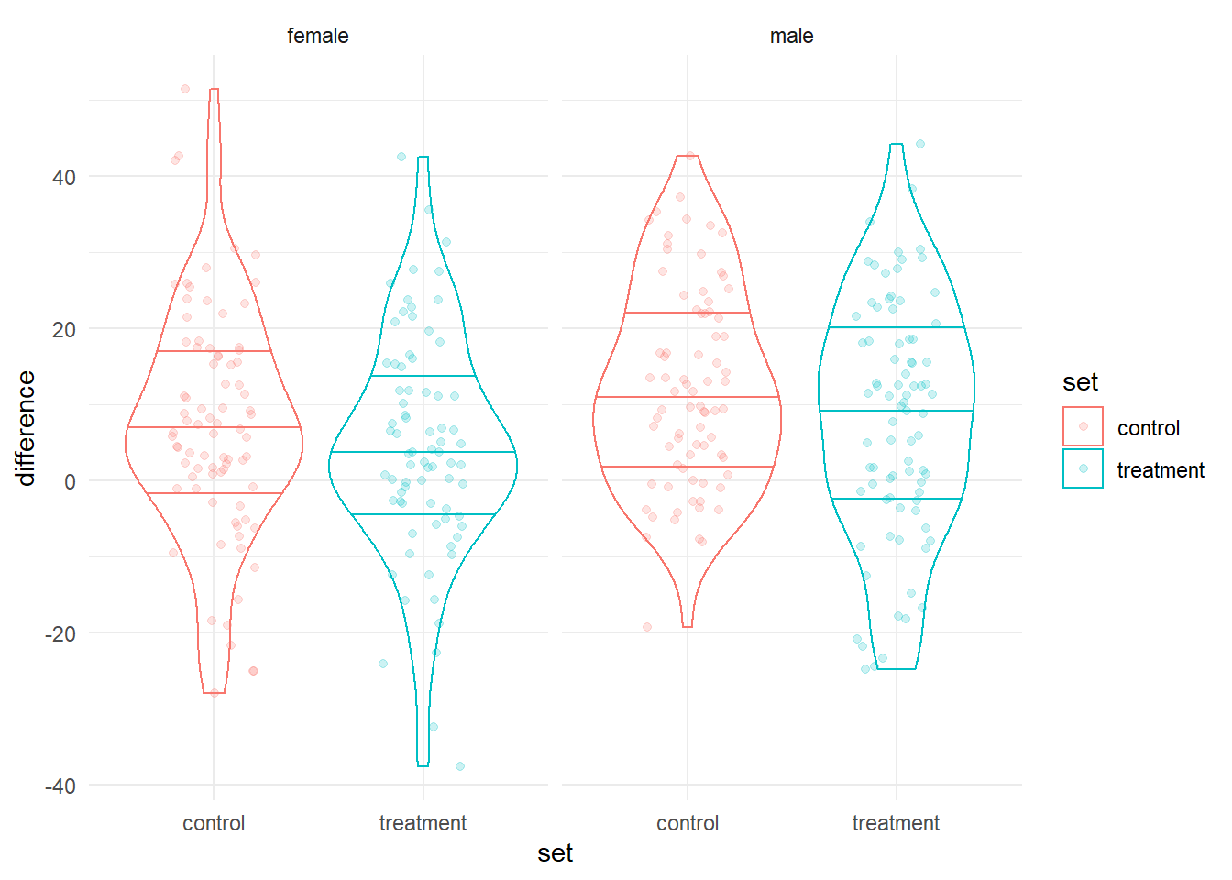
Learning

Slide 37
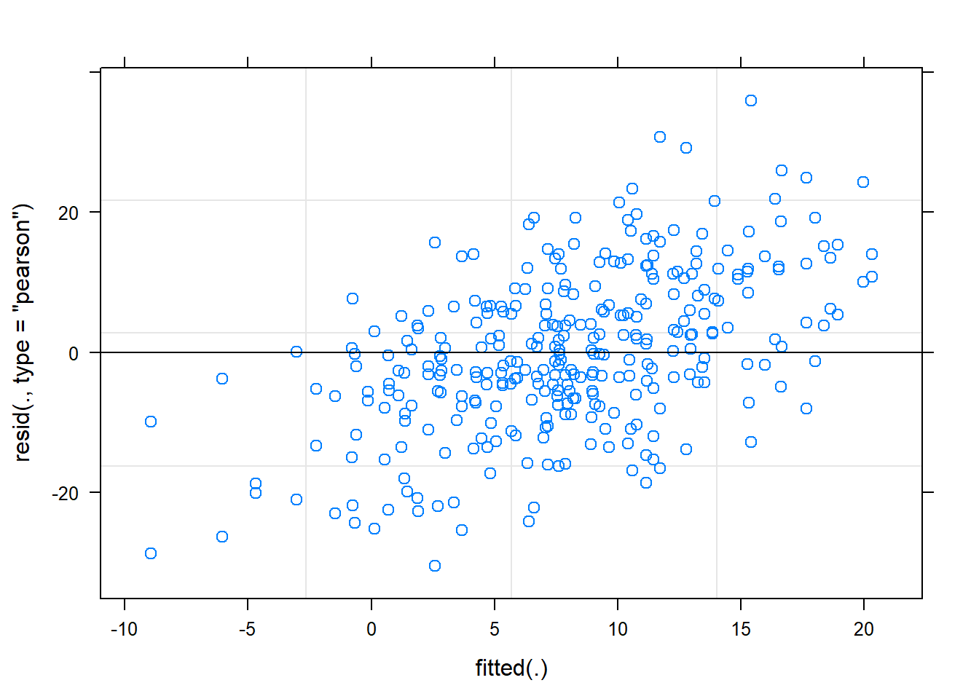
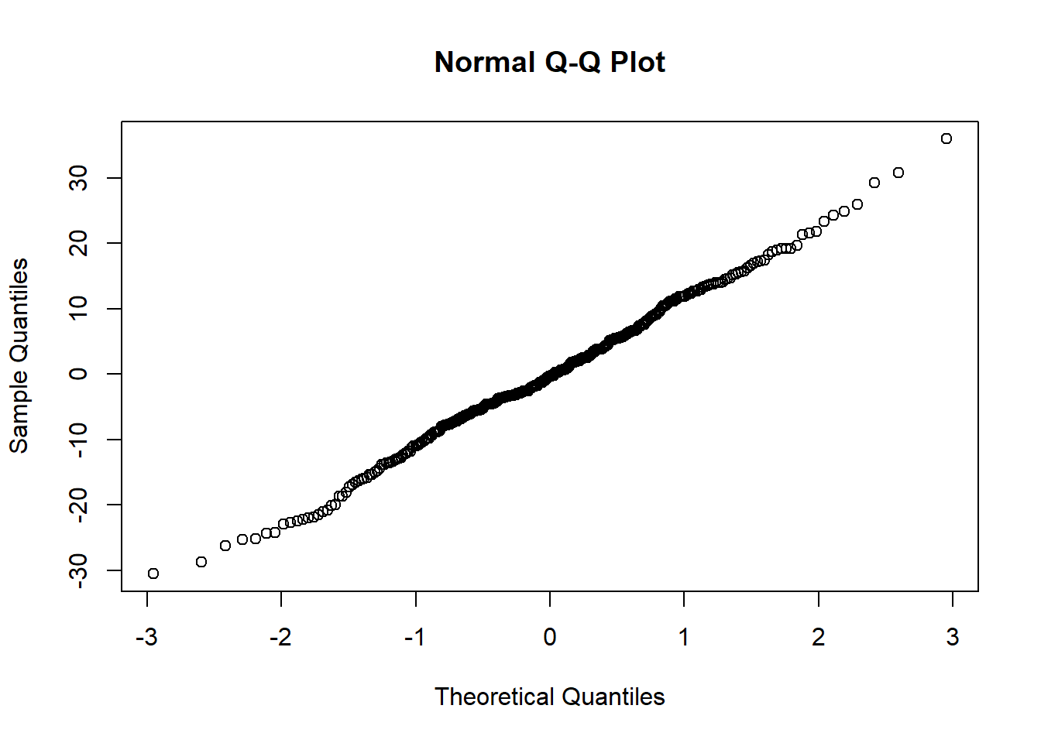
learning

Slide 38
learning
Predictors | Estimates | CI | p
(Intercept) | 7.62 | 4.51 – 10.72 | <0.001
set [treatment] | -3.56 | -7.19 – 0.06 | 0.054
sex [male] | 4.35 | 0.72 – 7.97 | 0.019
Random Effects
σ² | 162.09
τ₀₀ _{fishID} | 54.68
ICC | 0.25
N _{fishID} | 159
Observations | 318
Marginal R² / Conditional R² | 0.034 / 0.278

Slide 39
Plan for updated analysis and writing
Emulate structure of F1 methods chapter analysis
This involves, models for checking assumptions, performing transformations, conducting repeatability analyses and also variance analyses
Perform additional integrity checks
Begin putting together a methods section based on work already written

